Slide 1
SOA Exam FM
Module 3 – Section 4
Bond Notation and Terminology

Slide 2
Bond Example
You buy a 10-year 1000 face value bond with 8% semiannual coupons and a redemption value of 1200. The price of the bond is 1259.51 to yield 6% compounded semiannually.

Slide 3
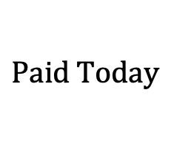
Bond Example
You buy a 10-year 1000 face value bond with 8% semiannual coupons and a redemption value of 1200. The price of the bond is 1259.51 to yield 6% compounded semiannually.
$$P=1259.51$$
$$Paid Today$$

Slide 4
Bond Example
You buy a 10-year 1000 face value bond with 8% semiannual coupons and a redemption value of 1200. The price of the bond is 1259.51 to yield 6% compounded semiannually.
$$P=1259.51$$
$$Paid Today$$
$i=0.03=seir$ (yield rate)

Slide 5
Bond Example
You buy a 10-year 1000 face value bond with 8% semiannual coupons and a redemption value of 1200. The price of the bond is 1259.51 to yield 6% compounded semiannually.
$$P=1259.51$$
$$Paid Today$$
$i=0.03=seir$ (yield rate)
$$R=1200$$

Slide 6
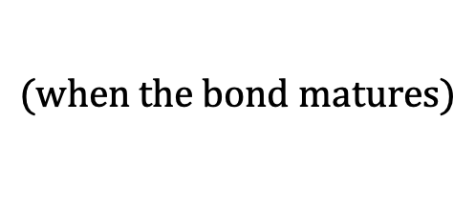
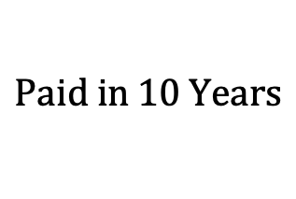
Bond Example
You buy a 10-year 1000 face value bond with 8% semiannual coupons and a redemption value of 1200. The price of the bond is 1259.51 to yield 6% compounded semiannually.
$$P=1259.51$$
$$Paid Today$$
$i=0.03=seir$ (yield rate)
$$R=1200$$
$$Paid in 10 Years$$
$$(when the bond matures)$$

Slide 7
Bond Example
You buy a 10-year 1000 face value bond with 8% semiannual coupons and a redemption value of 1200. The price of the bond is 1259.51 to yield 6% compounded semiannually.
$$P=1259.51$$
$$Paid Today$$
$i=0.03=seir$ (yield rate)
$$R=1200$$
$$Paid in 10 Years$$
$$(when the bond matures)$$
$$Coupons paid every 6 months for 10 years$$

Slide 8
Bond Example
You buy a 10-year 1000 face value bond with 8% semiannual coupons and a redemption value of 1200. The price of the bond is 1259.51 to yield 6% compounded semiannually.
$$P=1259.51$$
$$Paid Today$$
$i=0.03=seir$ (yield rate)
$$R=1200$$
$$Paid in 10 Years$$
$$(when the bond matures)$$
$$C=1000∙\frac{0.08}{2}=40$$
$$Coupons paid every 6 months for 10 years$$

Slide 9
Timeline
You buy a 10-year 1000 face value bond with 8% semiannual coupons and a redemption value of 1200. The price of the bond is 1259.51 to yield 6% compounded semiannually.
$$P=1259.51$$
$$Paid Today$$
$i=0.03=seir$ (yield rate)
$$R=1200$$
$$Paid in 10 Years$$
$$(when the bond matures)$$
$$C=1000∙\frac{0.08}{2}=40$$
$$Coupons paid every 6 months for 10 years$$
$$1200$$
$$40$$
$$40$$
$$⋯$$
$$40$$
$$⋯$$
$$1$$
$$2$$
$$20$$
$$P=1259.51$$

Slide 10
Notation and Terminology
$$P −Price of the Bond$$
$$i−Yield Rate (as a Periodic Effective Interest Rate)$$

Slide 11
Notation and Terminology
$$P −Price of the Bond$$
$$i−Yield Rate (as a Periodic Effective Interest Rate)$$
$$R−Redemption Value$$

Slide 12
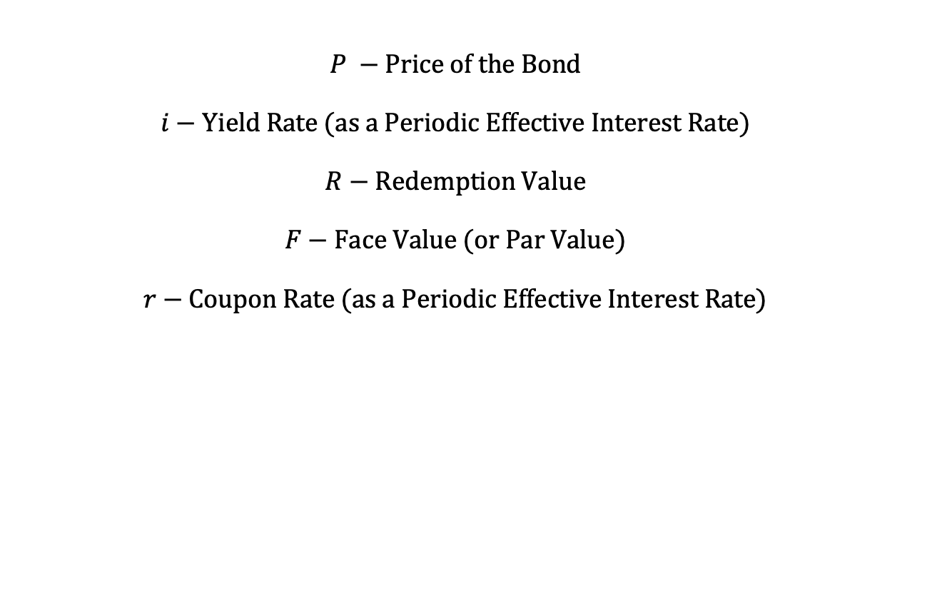
Notation and Terminology
$$P −Price of the Bond$$
$$i−Yield Rate (as a Periodic Effective Interest Rate)$$
$$R−Redemption Value$$
$$F−Face Value (or Par Value)$$
$$r−Coupon Rate (as a Periodic Effective Interest Rate)$$

Slide 13
Notation and Terminology
You buy a 10-year 1000 face value bond with 8% semiannual coupons and a redemption value of 1200. The price of the bond is 1259.51 to yield 6% compounded semiannually.
$$P=1259.51$$
$$i=0.03=seir$$
$$R=1200$$
$$F=1000$$
$$r=\frac{0.08}{2}=0.04$$

Slide 14
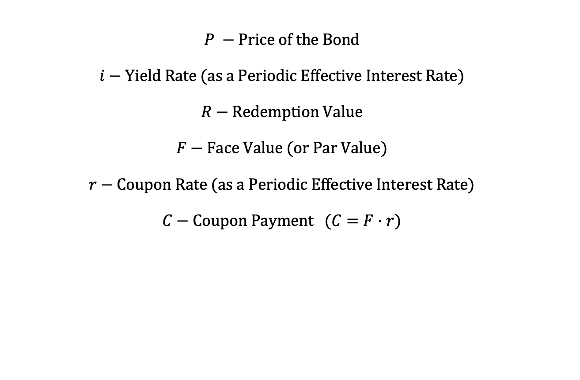
Notation and Terminology
$$P −Price of the Bond$$
$$i−Yield Rate (as a Periodic Effective Interest Rate)$$
$$R−Redemption Value$$
$$F−Face Value (or Par Value)$$
$$r−Coupon Rate (as a Periodic Effective Interest Rate)$$
$$C−Coupon Payment (C=F∙r)$$

Slide 15
Notation and Terminology
You buy a 10-year 1000 face value bond with 8% semiannual coupons and a redemption value of 1200. The price of the bond is 1259.51 to yield 6% compounded semiannually.
$$P=1259.51$$
$$i=0.03=seir$$
$$R=1200$$
$$F=1000$$
$$r=\frac{0.08}{2}=0.04$$
$$C=F∙r=40$$

Slide 16
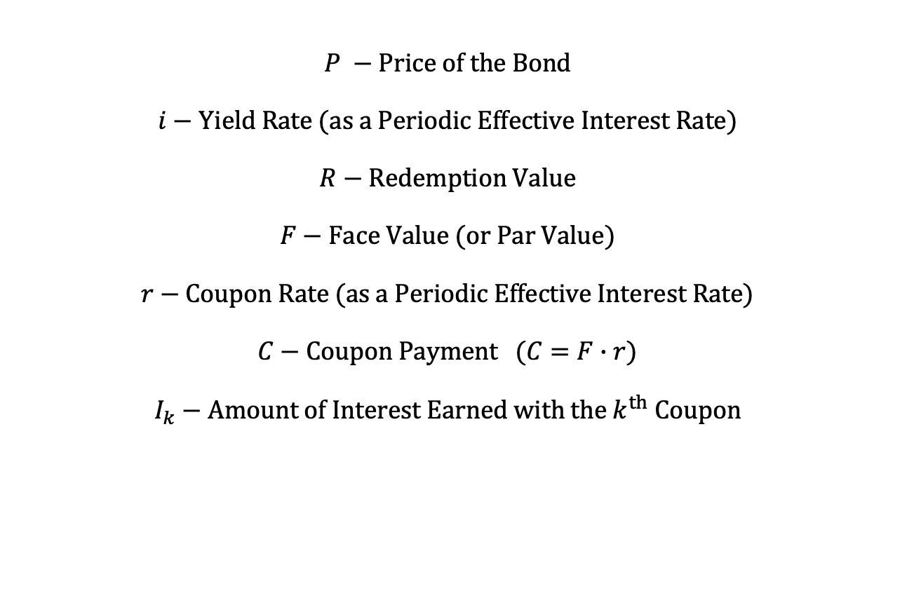
Notation and Terminology
$$P −Price of the Bond$$
$$i−Yield Rate (as a Periodic Effective Interest Rate)$$
$$R−Redemption Value$$
$$F−Face Value (or Par Value)$$
$$r−Coupon Rate (as a Periodic Effective Interest Rate)$$
$$C−Coupon Payment (C=F∙r)$$
$$I_{k}−Amount of Interest Earned with the k^{th} Coupon$$

Slide 17
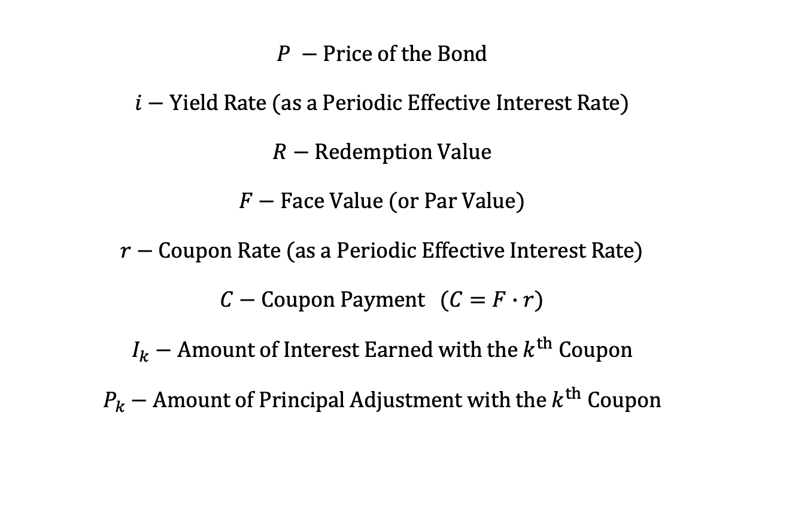
Notation and Terminology
$$P −Price of the Bond$$
$$i−Yield Rate (as a Periodic Effective Interest Rate)$$
$$R−Redemption Value$$
$$F−Face Value (or Par Value)$$
$$r−Coupon Rate (as a Periodic Effective Interest Rate)$$
$$C−Coupon Payment (C=F∙r)$$
$$I_{k}−Amount of Interest Earned with the k^{th} Coupon$$
$$P_{k}−Amount of Principal Adjustment with the k^{th} Coupon$$

Slide 18
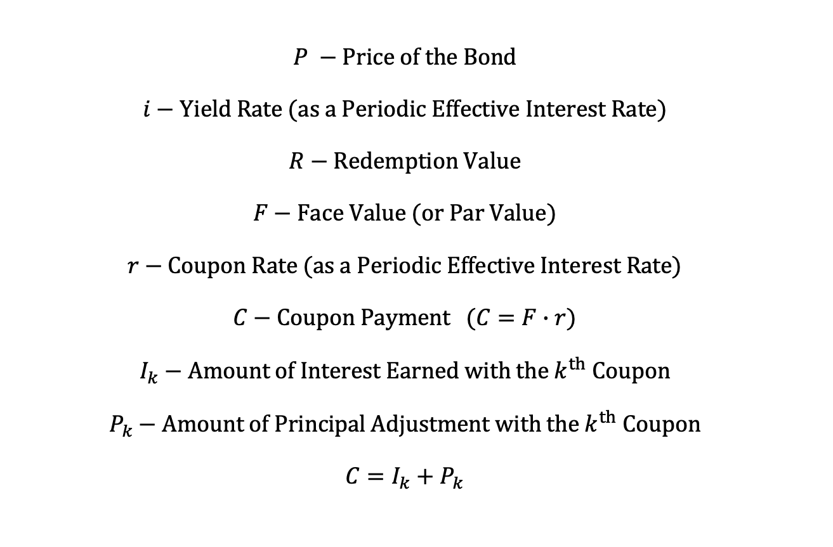
Notation and Terminology
$$P −Price of the Bond$$
$$i−Yield Rate (as a Periodic Effective Interest Rate)$$
$$R−Redemption Value$$
$$F−Face Value (or Par Value)$$
$$r−Coupon Rate (as a Periodic Effective Interest Rate)$$
$$C−Coupon Payment (C=F∙r)$$
$$I_{k}−Amount of Interest Earned with the k^{th} Coupon$$
$$P_{k}−Amount of Principal Adjustment with the k^{th} Coupon$$
$$C=I_{k}+P_{k}$$

Slide 19
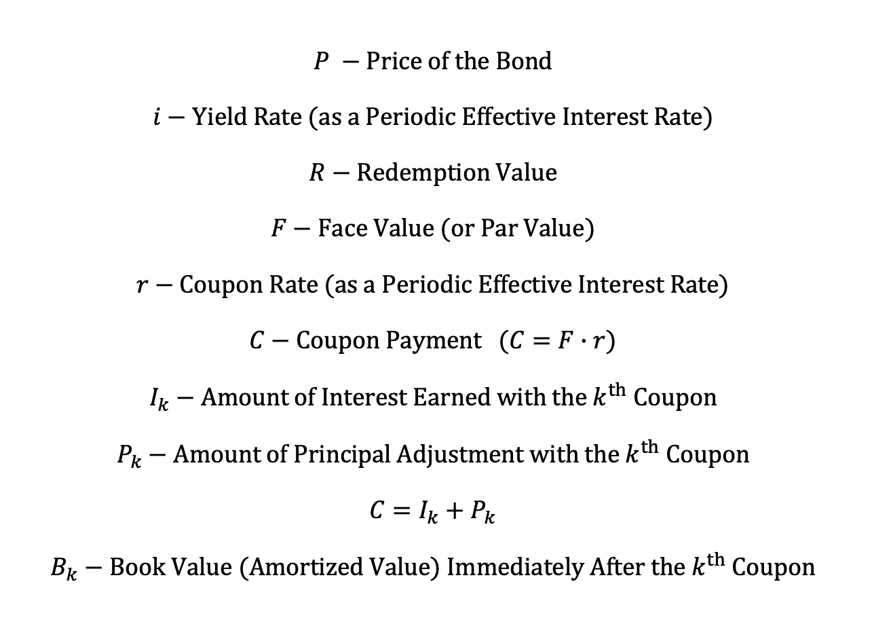
Notation and Terminology
$$P −Price of the Bond$$
$$i−Yield Rate (as a Periodic Effective Interest Rate)$$
$$R−Redemption Value$$
$$F−Face Value (or Par Value)$$
$$r−Coupon Rate (as a Periodic Effective Interest Rate)$$
$$C−Coupon Payment (C=F∙r)$$
$$I_{k}−Amount of Interest Earned with the k^{th} Coupon$$
$$P_{k}−Amount of Principal Adjustment with the k^{th} Coupon$$
$$C=I_{k}+P_{k}$$
$$B_{k}−Book Value (Amortized Value) Immediately After the k^{th} Coupon$$

Slide 20
Timeline
$$R$$
$$C$$
$$C$$
$$⋯$$
$$C$$
$$P$$
$$=Price$$

Slide 21
Timeline
$$C$$
$$C$$
$$⋯$$
$$C$$
$$⋯$$
$$P$$
$$=Price$$
$$B_{k}$$
$$=book value just after k^{th} coupon$$

Slide 22
Timeline
$$R$$
$$C$$
$$C$$
$$⋯$$
$$C$$
$$P$$
$$=Price$$
$$=B_{0}$$

Slide 23
Timeline
$$R$$
$$C$$
$$C$$
$$⋯$$
$$C$$
$$P$$
$$=Price$$
$$=B_{0}$$
$$B_{n}$$

Slide 24
Timeline
$$R$$
$$C$$
$$C$$
$$⋯$$
$$C$$
$$P$$
$$=Price$$
$$=B_{0}$$
$$B_{n}$$
$$=R$$

Slide 25
Timeline
$$R$$
$$C$$
$$C$$
$$⋯$$
$$C$$
$$P$$
$$=Price$$
$$=B_{0}$$
$$B_{n}$$
$$=R$$
$$\left(\begin{aligned}The last coupon is paid at time n^{−} \\ The redemption value is paid at time n^{+}\end{aligned}\right)$$

Slide 26
Timeline
$$C$$
$$C$$
$$⋯$$
$$C$$
$$⋯$$
$$P$$
$$=Price$$
$$B_{k}$$
$$=book value just after k^{th} coupon$$

Slide 27
Timeline
$$C$$
$$C$$
$$⋯$$
$$C$$
$$⋯$$
$$P$$
$$=Price$$
$$B_{k}$$
$$=book value just after k^{th} coupon$$
$$book value just before k^{th} payment$$
$$=B_{k}^{bef}$$

Slide 28
Timeline
$$C$$
$$C$$
$$⋯$$
$$C$$
$$⋯$$
$$P$$
$$=Price$$
$$B_{k}$$
$$=book value just after k^{th} coupon$$
$$book value just before k^{th} payment$$
$$=B_{k}^{bef}$$
$$B_{k}^{bef}−C=B_{k}$$

Slide 29

Timeline
$$C$$
$$C$$
$$⋯$$
$$C$$
$$⋯$$
$$P$$
$$=Price$$
$$B_{k}$$
$$=book value just after k^{th} coupon$$
$$book value just before k^{th} payment$$
$$=B_{k}^{bef}$$
$$B_{k}^{bef}−C=B_{k}$$
$$⇒ B_{k}^{bef}=B_{k}+C$$

Slide 30
Timeline
$$C$$
$$C$$
$$⋯$$
$$C$$
$$⋯$$
$$P$$
$$=Price$$
$$B_{k}$$
$$=book value just after k^{th} coupon$$

Slide 31
Timeline
$$C$$
$$C$$
$$⋯$$
$$C$$
$$C$$
$$⋯$$
$$P$$
$$=Price$$
$$B_{k}$$
$$=book value just after k^{th} coupon$$

Slide 32
Timeline
$$C$$
$$C$$
$$⋯$$
$$C$$
$$C$$
$$⋯$$
$$P$$
$$=Price$$
$$B_{k}$$
$$=book value just after k^{th} coupon$$
$$B_{k−1}$$
$$=book value just after {(k−1)}^{st} coupon$$

Slide 33
Timeline
$$C$$
$$C$$
$$⋯$$
$$C$$
$$C$$
$$⋯$$
$$P$$
$$=Price$$
$$B_{k}$$
$$=book value just after k^{th} coupon$$
$$B_{k−1}$$
$$=book value just after {(k−1)}^{st} coupon$$
$$B_{k}^{bef}=B_{k−1}∙\left(1+i\right)$$

Slide 34
Timeline
$$C$$
$$C$$
$$⋯$$
$$C$$
$$C$$
$$⋯$$
$$P$$
$$=Price$$
$$B_{k}$$
$$=book value just after k^{th} coupon$$
$$B_{k−1}$$
$$=book value just after {(k−1)}^{st} coupon$$
$$B_{k}^{bef}=B_{k−1}∙\left(1+i\right)$$
$$B_{k}^{bef}=B_{k}+C$$

